Slide 1

Concluding Remarks – Day 1
DARPA Triage Challenge Kick-Off Meeting
CDR Jean-Paul Chretien, M.D., Ph.D., MC, USN
Program Manager
Biological Technologies Office (BTO)
November 6, 2023
Distribution Statement ‘A’ (Approved for Public Release, Distribution Unlimited)

Slide 2

Day 1 final thoughts
Ensure NDAA compliance
Complete FAA Part 107
Challenge Rules draft coming soon
Sign up for the newsletter TriageChallenge.DARPA.mil
Qualification window through November 13, 2023
Discourse Forum coming soon for communication
  Teams – IV&V
  Teams – Virtual platform
  Teams – Teams

Slide 3
DTC Kick-off Agenda Day 2
Distribution Statement ‘A’ (Approved for Public Release, Distribution Unlimited)

Slide 4
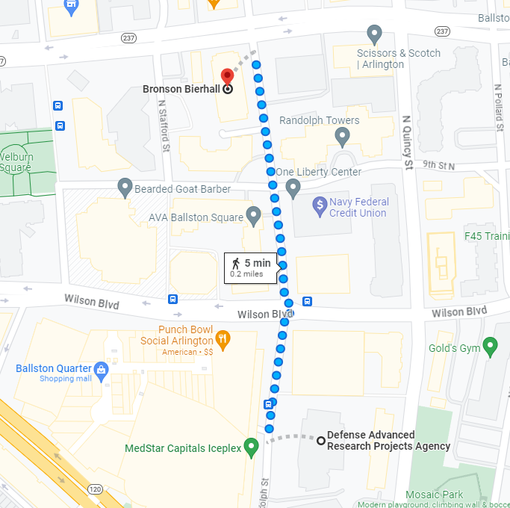

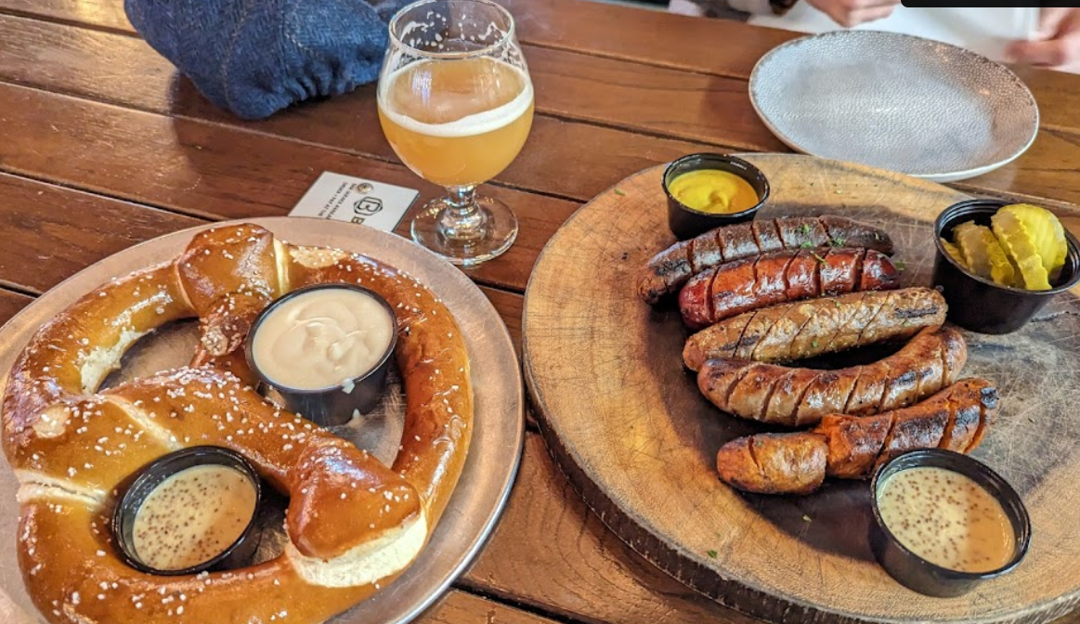
No-Host Social @ Bronson Bierhall
6:00 – 7:30pm
4100 Fairfax Dr, Arlington, VA 22203
Distribution Statement ‘A’ (Approved for Public Release, Distribution Unlimited)

